Slide 1

Mental Health Awareness and Empathetic Communication Skills

Slide 2
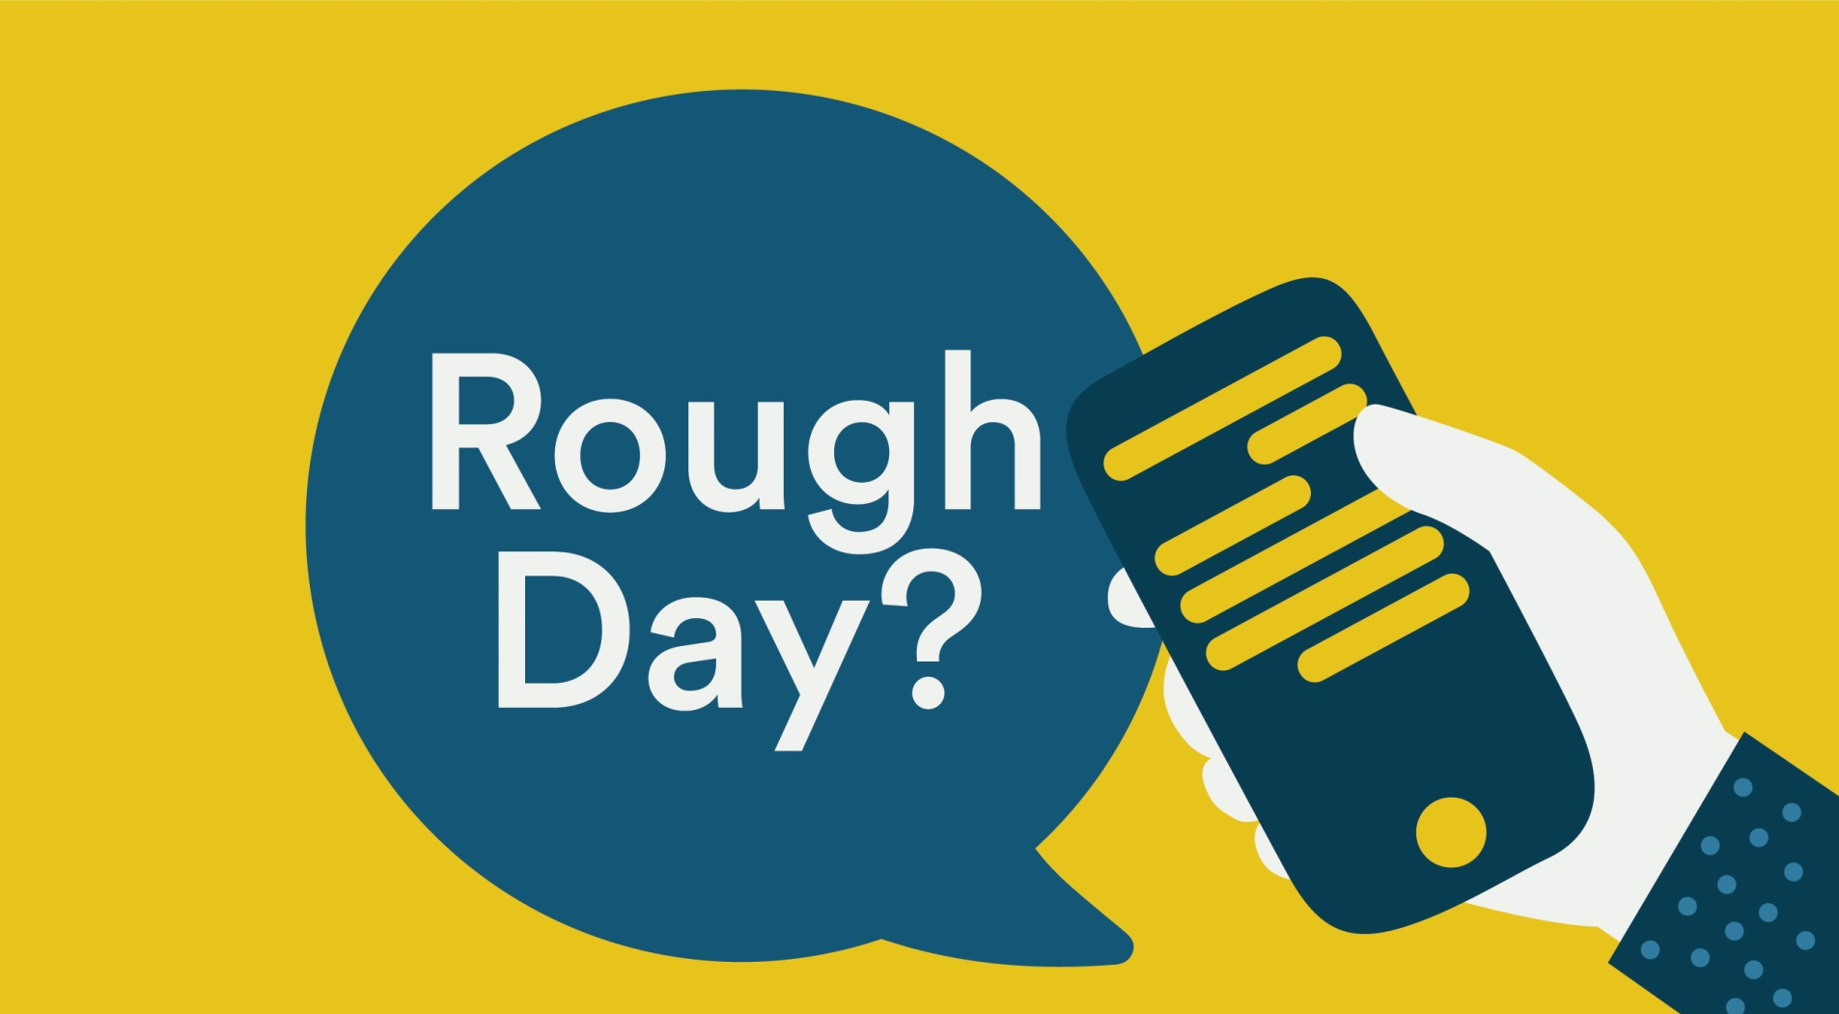

Common Issues from c
1. “I miss my personal support network, as I’m living away from my family & friends.”
7. "I enjoy my work but once I close my door, I'm incredibly lonely."
2. “I’m worried about my finances.”
8. “Moving has been really difficult for my mental health & well-being.”
9. “I still need to adjust to a different business culture / work environment.”
3. “I have trouble making new friends. I’m so lonely.”
4. “I’m single and find it very difficult to establish a relationship.”
10. “The language barrier is a problem for me.”
5. “My family doesn't understand the life I live, its very different than their own.”
11. “I have had some trouble with culture shock.”
6. “I can't afford to see a therapist, my medical insurance is so limited."
12. “My partner / family doesn’t seem happy with the decision to move here.”
Notes:
And because you care – you can help by learning and asking “R U OK?”

Slide 3
Examples of positive coping mechanisms
Being able to recognize and prepare for situations/times/people that might cause you increased stress and planning techniques to use to help you deal with these:
Internal resources: scheduling time for the activities and/or people you enjoy each day, using breath techniques to reduce your heart rate, practicing a gratitude list to develop a positive attitude, journaling to express your emotions, prioritizing self-care
External resources: identifying those in your own support network (family members, friends, colleagues, neighbors) & making regular contact with them, asking for help at home or at work when you are feeling overwhelmed, sharing how you feel by reaching out for support to a counselor or Lifeline ☺

Slide 4






Which of these coping strategies are positive or negative?

Slide 5
Mental health awareness & functioning means….
….building our own resilience through identifying internal and external resources to use as support during difficult times. Let’s share…
What are some of the internal and external resources that you use to cope during challenging times?

Slide 6
Helping others in the workplace: Support vs Advice
Supportive conversation techniques demonstrate our care and willingness to listen to our caller’s concerns
Our callers feel more supported when their feelings and emotions are recognized and understood by the listener
EXAMPLES
A: I think you are stressed & working really hard preparing online lessons and you need to take care of yourself more
S: I hear you say you feel overwhelmed by your workload right now. Have you planned something to take care of yourself today?

Slide 7
Support vs Advice in the workplace – more examples
A: You’re probably more anxious than usual because of this virus situation
S: Where do you think your feelings of anxiety might be coming from?
A: Perhaps you should try to contact your family
S: Where do you think you could ask for abit more support right now?
A: It would be good if you could exercise each day as that will help you feel more positive
S: What kind of exercise activities do you usually enjoy doing? Are you able to do any of those where you are?

Slide 8
Empathetic Conversation Skills
In empathetic conversations we place our full focus on the person and what they are trying to communicate to us
Our responses show our careful understanding of the person’s distress
We try hard to ensure our caller feels valued and supported by us by not interrupting or talking over them

Slide 9
Empathetic Communication Toolbox
Includes: effective questioning, pausing & reflecting
1. Effective questions - These can help to start a conversation, encourage expression of emotion, gather information, provide clarity and explore options and create rapport.
Close-ended questions give you specific ‘yes’ or ‘no’ answers to questions
Eg. Are you annoyed that you have to stay inside all day? Have you tried to go outside?

Slide 10
Empathetic Communication Toolbox cont…
Open-ended questions allow the caller more freedom to direct the conversation and vent emotions. This type of question is especially important for callers who are not so willing to open up.
Eg. Could you tell me more? (Particularly useful at the beginning of a conversation)
How are you feeling about that now? How did that come about? What other options have you considered?

Slide 11
Empathetic Communication Toolbox cont…
2. Reasons to reflect the caller’s emotions…
Allows the caller to feel understood
Helps the caller gain perspective on themselves/their situation
Helps you clarify what you have heard/understood about the caller
How to reflect a person’s emotions:
State what you feel the caller is feeling by paraphrasing or repeating their words
Eg. “I am feeling anxious about what will happen” → “So you feel some uncertainty about the future?”/ “I am pissed I can’t come back” → “It sounds like you are upset that you cannot return yet”

Slide 12
Empathetic Communication Toolbox cont…
3. Power of a pause A key here is to be comfortable with allowing the caller space to share their feelings
Reasons to pause:
To allow time for the caller to think and process
To allow time for the caller to release emotions
To allow time for you to really understand the caller’s responses
When to pause
the caller is expressing strong emotions
after you reflect back what they have said
after you ask a question
when you unsure what to say

Slide 13
Do you have any questions about Empathetic Conversation skills? Write them down and bring them to training Day 1

