Slide 1
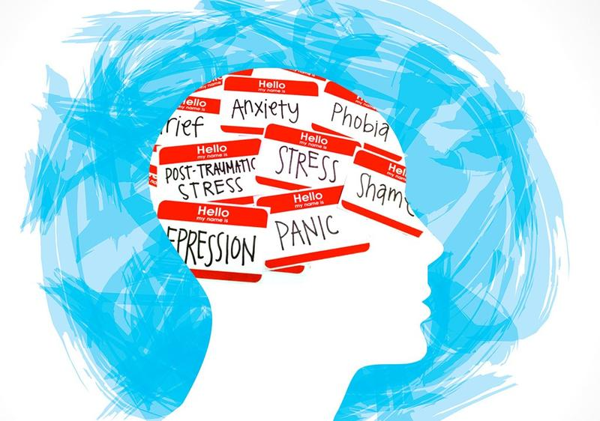
Lifeline & Mental Health Awareness

Slide 2
Outline
Introduction to Lifeline
Mental health awareness/functioning
Coping skills & strategies
Benefits of calling a helpline
Volunteering at Lifeline/Questions

Slide 3
Lifeline
Helpline services in England since 1953
Originated in Australia in 1963
By Reverend Sir Dr. Allan Walker
Primarily as suicide crisis prevention but extended to further support
Started in Shanghai in 2005 & and nationwide in China in 2019

Slide 4
What services does Lifeline provide?
Anonymous English speaking service with volunteers from a wide range of nationalities
Provides service through the telephone and online operating 10am-10pm 365 days a year
Operates as a helpline for those in crisis or experiencing distress through life challenges or changes in circumstance etc

Slide 5
Who calls Lifeline?
75% telephone calls/25% online chats
65% women/35% men
Wide range of callers & chatters (nationality, professional background, age etc) but all services are provided in english
Includes calls/chats from those under 18 year olds
60% of calls/chats from those who identify as being Chinese

Slide 6

What are they calling about?
Caller statistics from previous years:
37% relationships
25% related to a mental condition
15% to ‘vent’
13 % other concerns
10% homesickness

Slide 7
Mental health awareness
Defined by the WHO as being, ‘able to participate in or adapt constructively to changes in one’s social or physical environment as well as the capacity of the individual to form harmonious relations with others
Mental health is used to indicate a state of psychological wellbeing and/or to indicate its opposite ie. problems with psychological wellbeing

Slide 8
Mental health awareness
Includes the fulfillment of an individual’s emotional, intellectual and spiritual potential
Can include wellbeing, self-actualization, intrapersonal & interpersonal interaction
Not in terms of psychological ‘normality’ or ‘abnormality’
Closely linked to prevention of mental health problems

Slide 9
Mental health functioning
Determined by an individual’s level of adaptive functioning in their personal and professional lives (eg. capability of engaging in fulltime/part-time work; maintaining personal relationships with family and friends)
Relates to an individual’s ability to respond to life changes or distress/stress caused by these changes in adaptive ways

Slide 10
Mental health functioning
Response to life changes (ie. job loss, relationship breakdowns, physical health problems etc) → problems with mental health functioning
How an individual deals with stress/distress caused by challenges in life as either adaptive or maladaptive → further influencing mental health functioning (egs. substance use/abuse, self-harm etc)

Slide 11
Coping skills & strategies
Building our own skills and resilience through identifying internal and external resources to use as support in difficult time
Knowing what is useful to you/knowing what helps you in situations of increased anxiety, stress, distress, depression, pressure etc

Slide 12
Coping skills & strategies
Internal resources: checking in with yourself, being able to recognise and prepare for situations/times/people that might cause you increased stress, planning techniques to help you deal with stress (using your breath, practice maintaining awareness in the present moment, using gratitude awareness, journaling, practicing self-care etc)

Slide 13
Coping skills & strategies
External resources: identifying those your own support network (family, friends, neighbours colleagues), reaching out to others, sharing how you feel, asking for help at home and/or at work, CALLING LIFELINE ☺, reaching out for extended support through Shanghai’s counseling network or online through your own countries services

Slide 14
Coping skills & strategies
External resources: identifying those your own support network (family, friends, neighbours colleagues), reaching out to others, sharing how you feel, asking for help at home and/or at work, CALLING LIFELINE ☺, reaching out for extended support through Shanghai’s counseling network or online through your own countries services; using BC support services

Slide 15
What strategies do you currently use to cope?
Which would you like to use more of?

Slide 16
Benefits of calling Lifeline
✔ skilled volunteers who are trained to assist you in wide range of situations
✔ completely free
✔ totally anonymous
✔ accessible in any city you are placed in
✔ can offer support & help you plan the next step
✔ provide referral services for further counseling/therapy

